Slide 1
StudentMania
Discord for Students
By
Jack Haugh G00359747
Kevin Flanagan G00228079
Stephen Gallagher G00314689

Slide 2
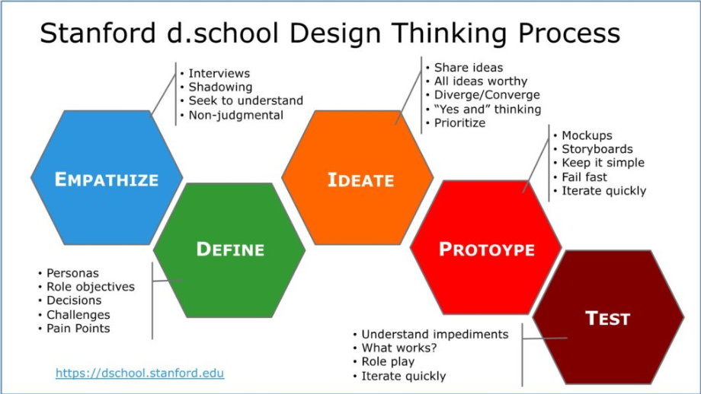

Slide 3
Objectives
Website for Students
Share content & files
Chat with other students

Slide 4
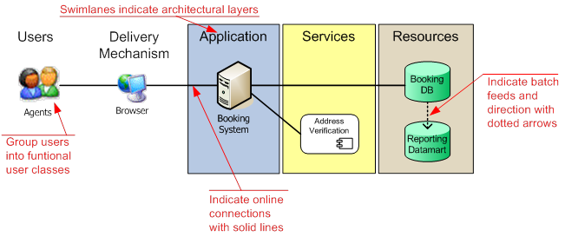
Architecture
How its built!

Slide 6
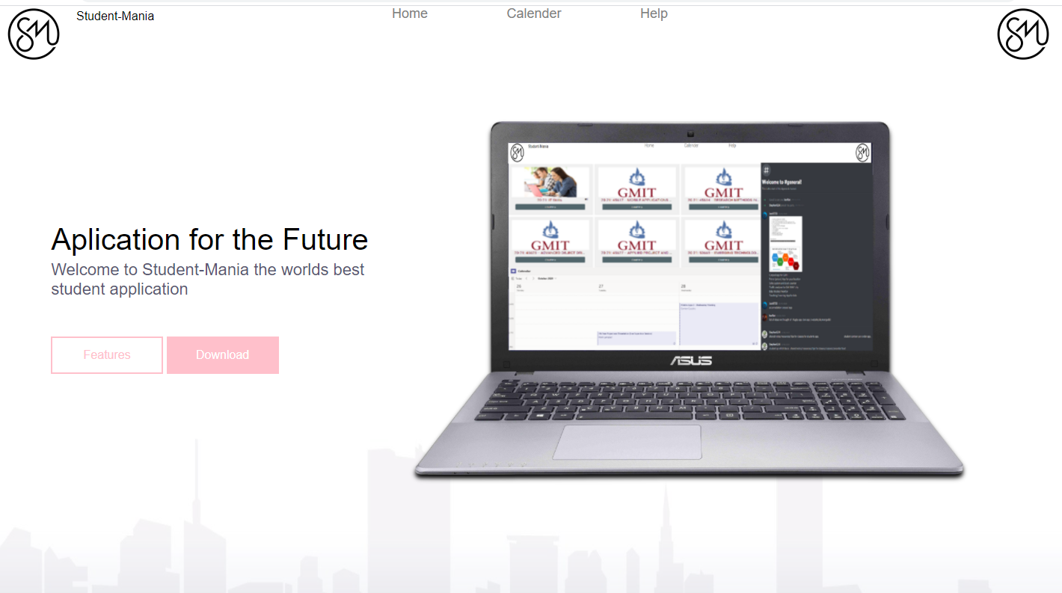
StudentMania

Slide 7
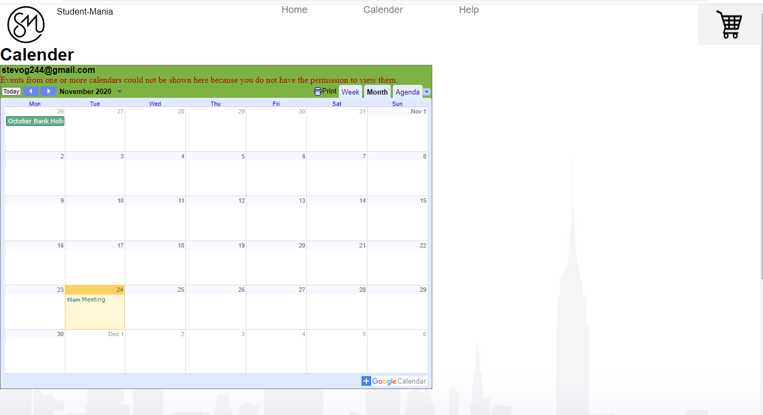

Slide 8
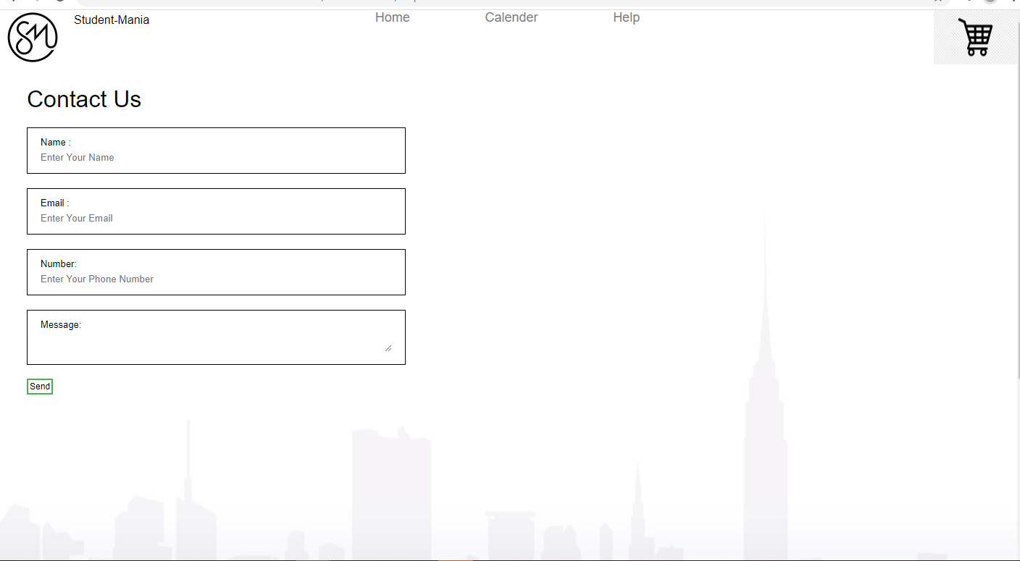

Slide 9
Plan for semitrue 2
Chatbox?
Login?
Video?
Modules for student
Help section

Slide 10
Demo of the prototype
Link to website!
Show it off!

